Slide 1
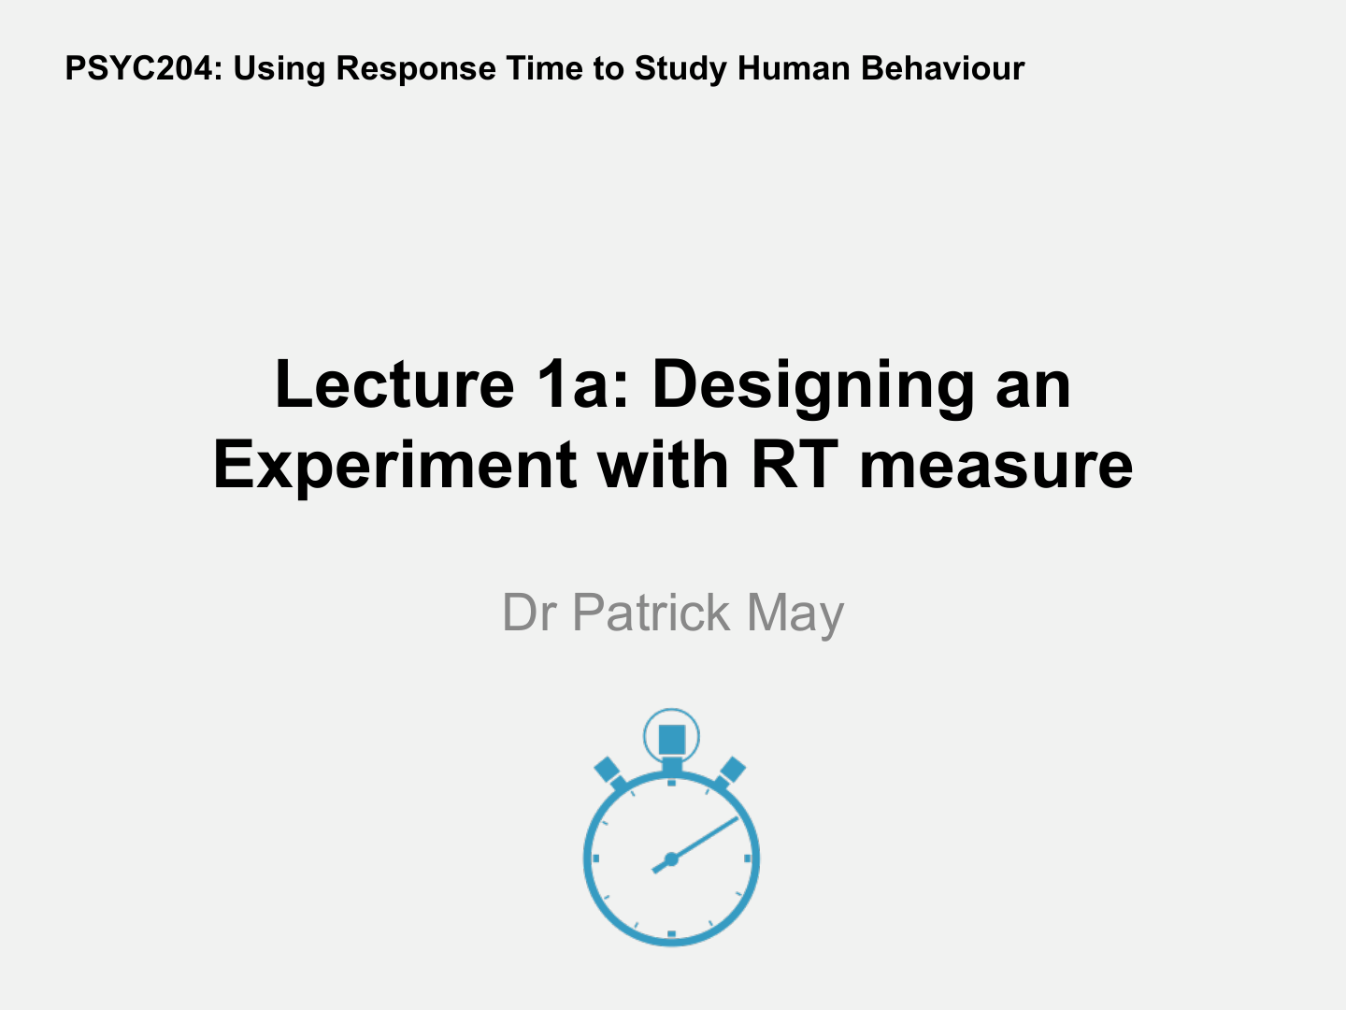
Dr Patrick May

Slide 2
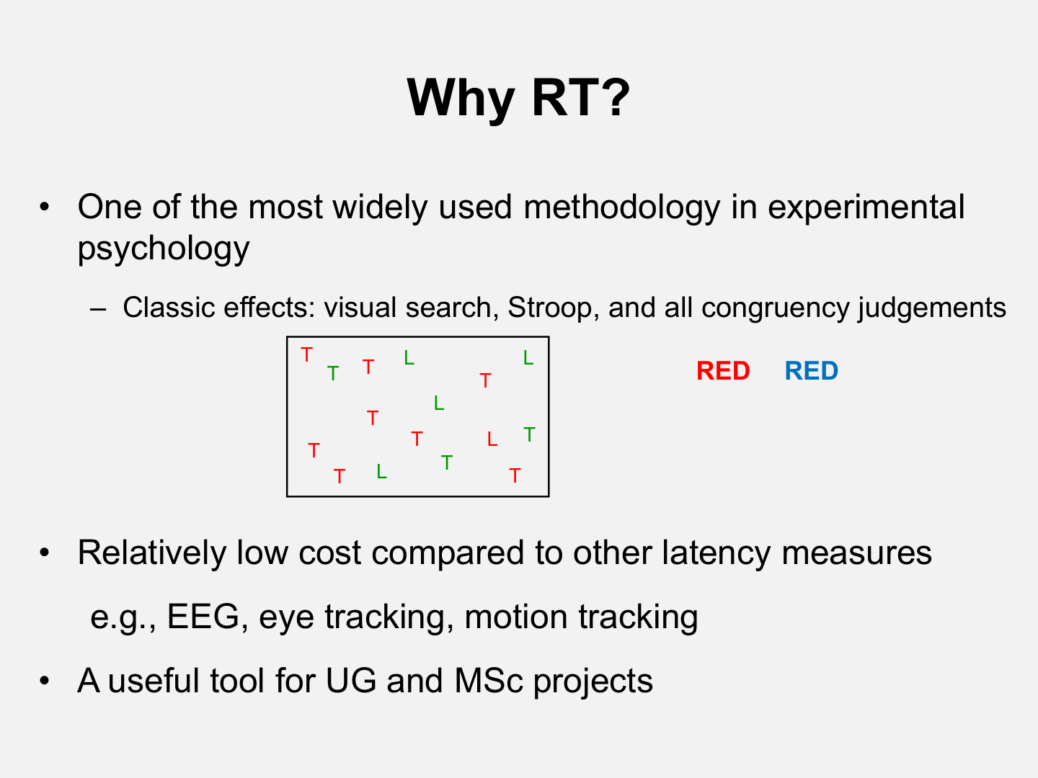
Why RT?
T
T
T
T
T
L
T
L
T
T
T
L
T

Slide 3
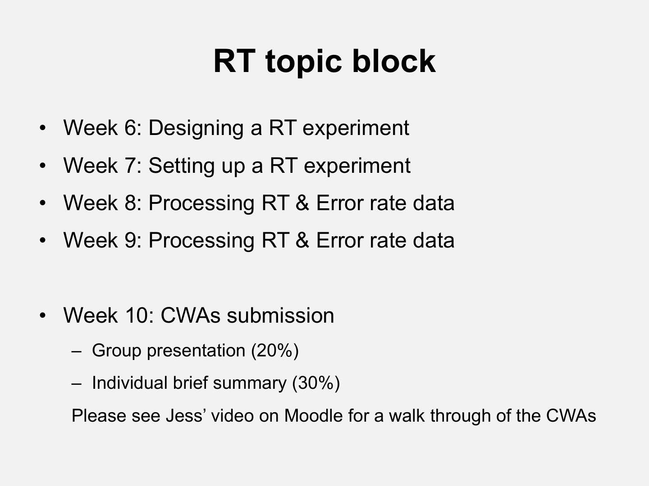
RT topic block
Week 5: Designing an RT experiment
Week 6: Setting up an RT experiment
Week 7: Processing RT and Error rate data
Week 8: Processing RT and Error rate data
----
Week 9: Ethics
----
Week 10: Beginning of Qualitative Research Methods block of learning
• Week 8: Processing RT & Error rate data
• Week 9: Processing RT & Error rate data
• Week 10: CWAs submission
– Group presentation (20%)
– Individual brief summary (30%)
Please see Jess’ video on Moodle for a walk through of the CWAs

Slide 4
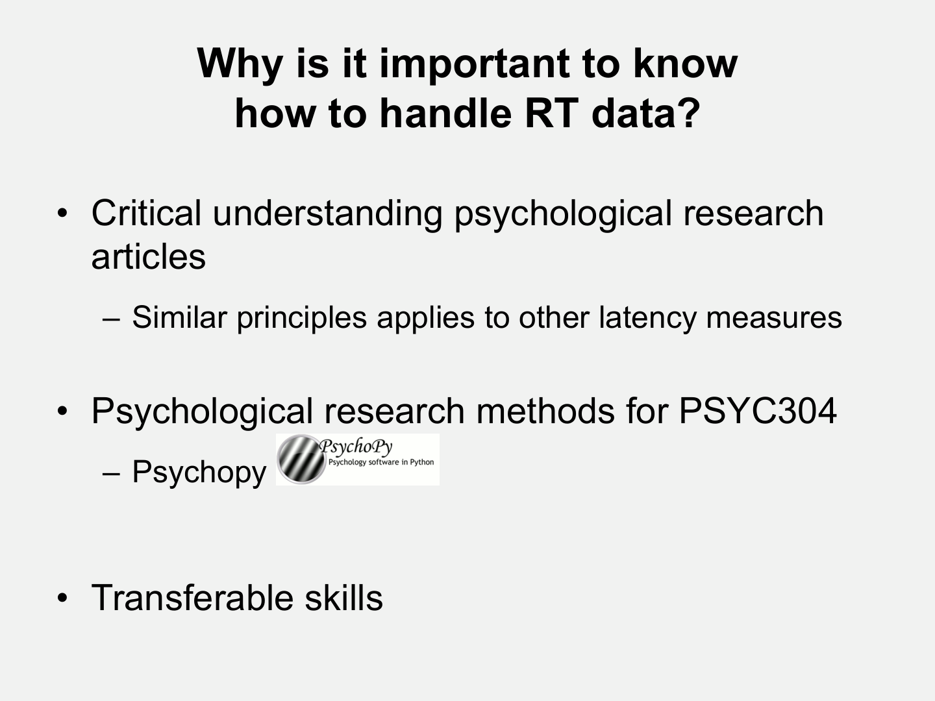
PSYC6041
– Psychopy
• Transferable skills

Slide 5
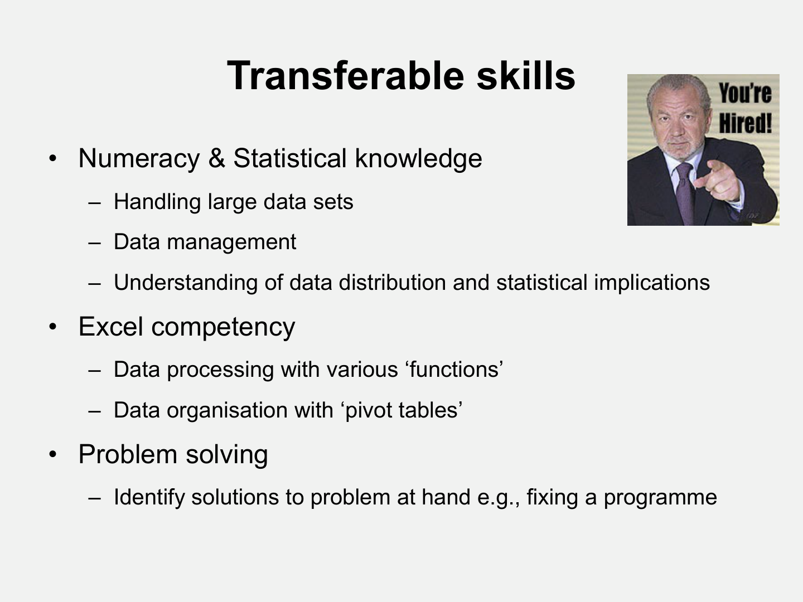
Transferable skills
• Numeracy & Statistical knowledge
– Handling large data sets
– Data management
– Understanding of data distribution and statistical implications
• Excel competency
Consolidation of practice of handling data in RStudio
– Data processing with various ‘functions’
– Data organisation with ‘pivot tables’
• Problem solving
– Identify solutions to problem at hand e.g., fixing a programme

Slide 6
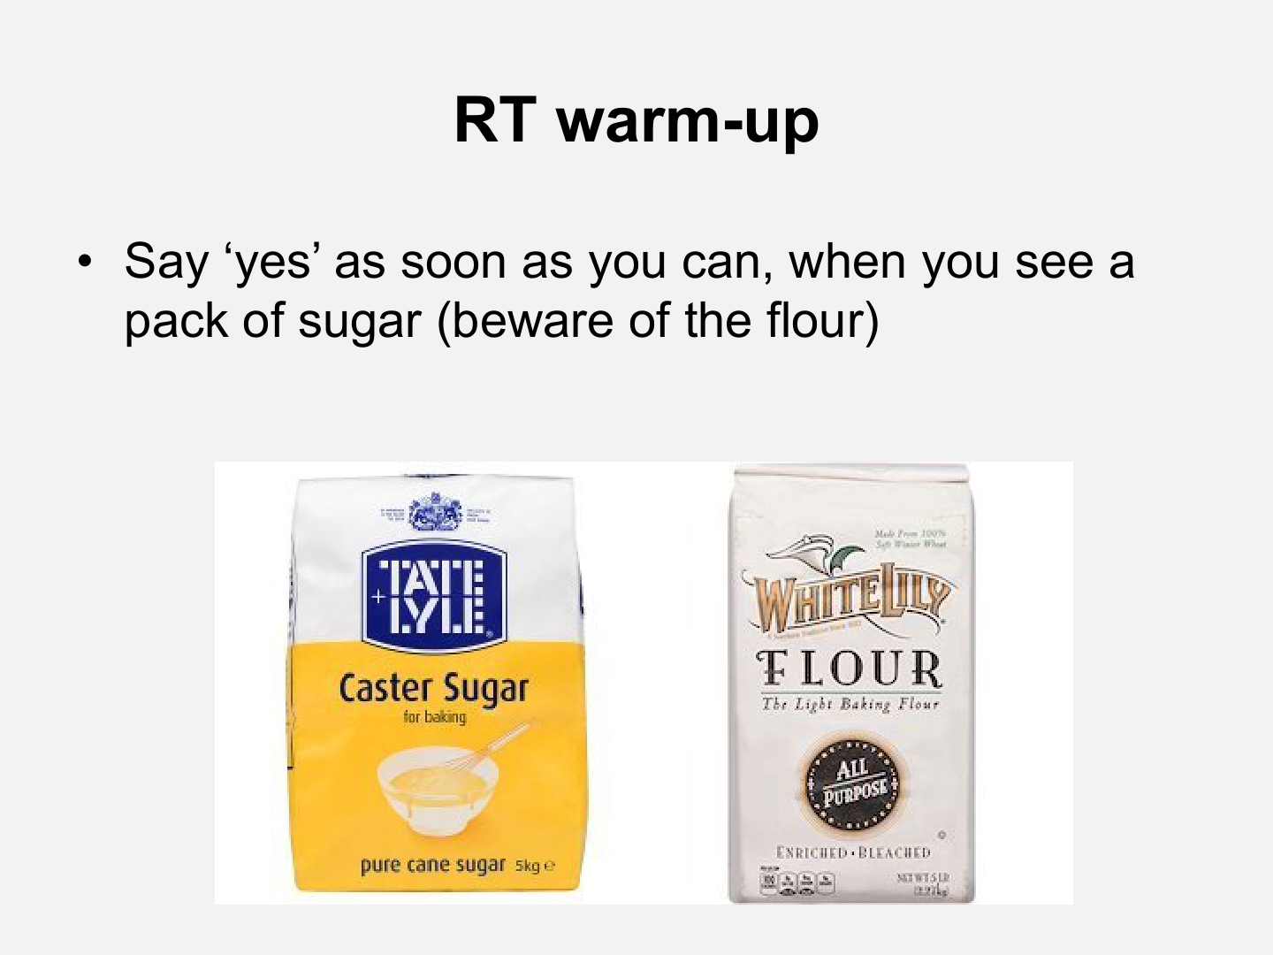


RT warm-up

Slide 8
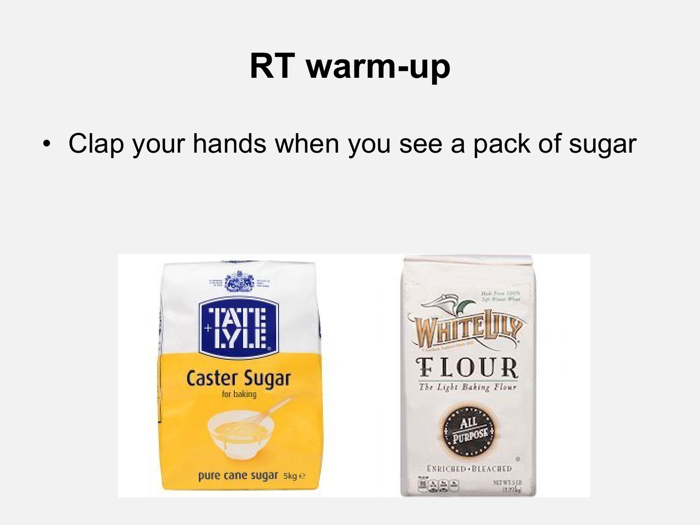
RT warm-up

Slide 10
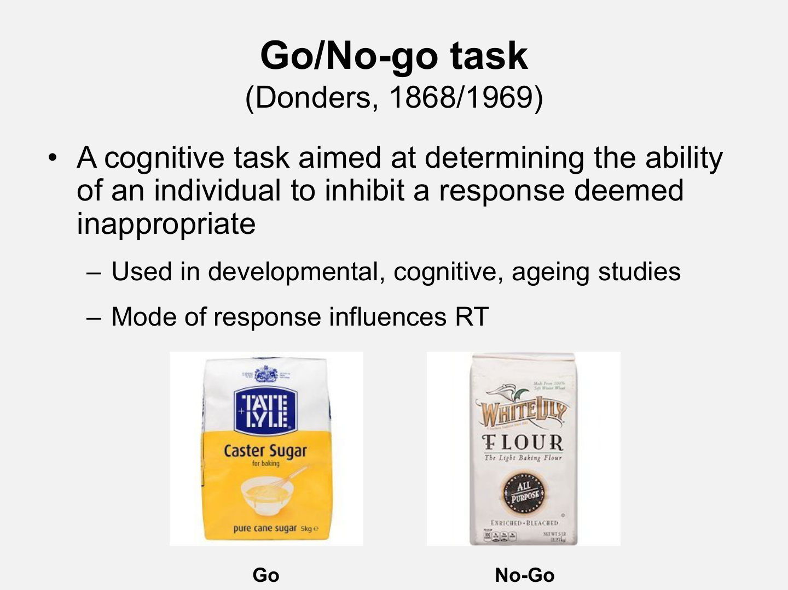
Go/No-go task
(Donders, 1868/1969)
• A cognitive task aimed at determining the ability
of an individual to inhibit a response deemed
inappropriate
– Used in developmental, cognitive, ageing studies
– Mode of response influences RT
Go
No-Go

Slide 11
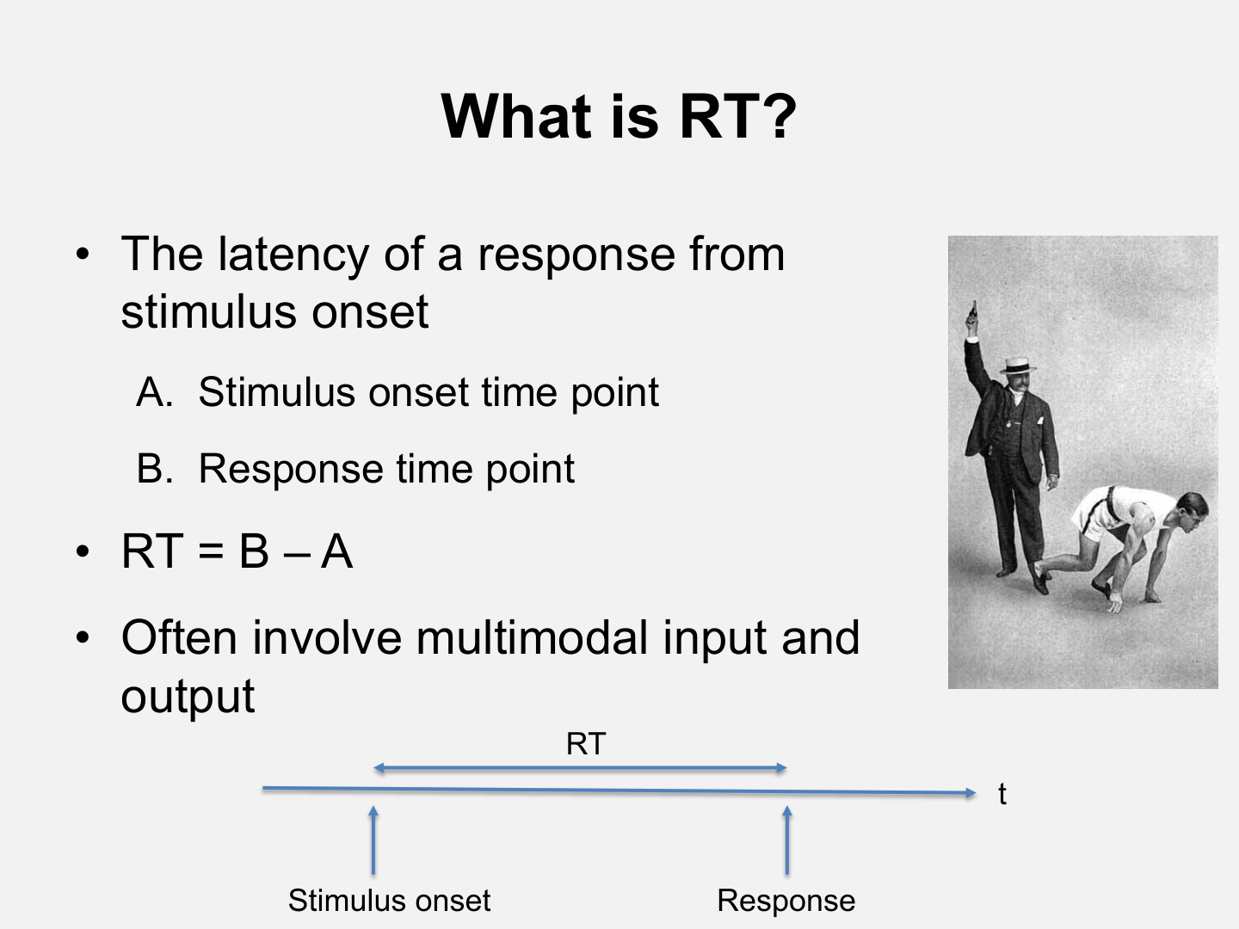
What is RT?
• The latency of a response from
stimulus onset
A. Stimulus onset time point
B. Response time point
• RT = B – A
• Often involve multimodal input and
output
RT
t
A
B
Stimulus onset
Response

Slide 12
What is RT?
• The latency of a response from
stimulus onset
A. Stimulus onset time point
B. Response time point
• RT = B – A
• Often involve multimodal input and
output
RT
t
A
B
Stimulus onset
Response

Slide 13
What is RT?
• The latency of a response from
stimulus onset
A. Stimulus onset time point
B. Response time point
• RT = B – A
• Often involve multimodal input and
output
RT
t
A
B
Stimulus onset
Response

Slide 14
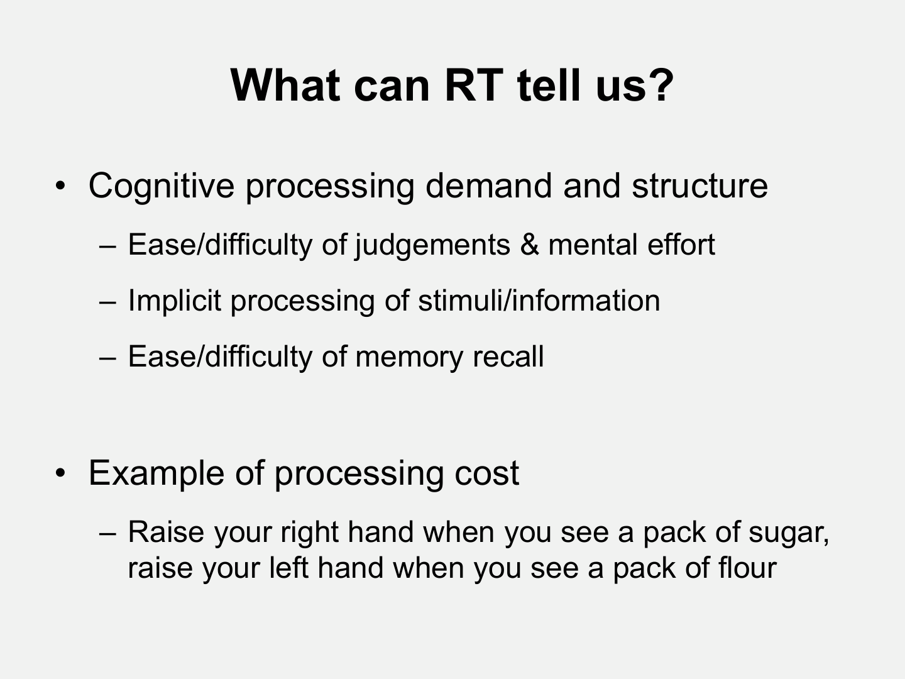
What can RT tell us?

Slide 15
Stroop Task
Conflicting: RED GREEN BLUE YELLOW
Non-conflicting: RED GREEN BLUE YELLOW

Slide 16
What can RT tell us?

Slide 17
Processing Cost: Practice

Slide 18
Processing Cost: Practice

Slide 19
Processing Cost: Test
Ready?

Slide 27
Simon Effect
(Simon & Rudell, 1967)

Slide 28
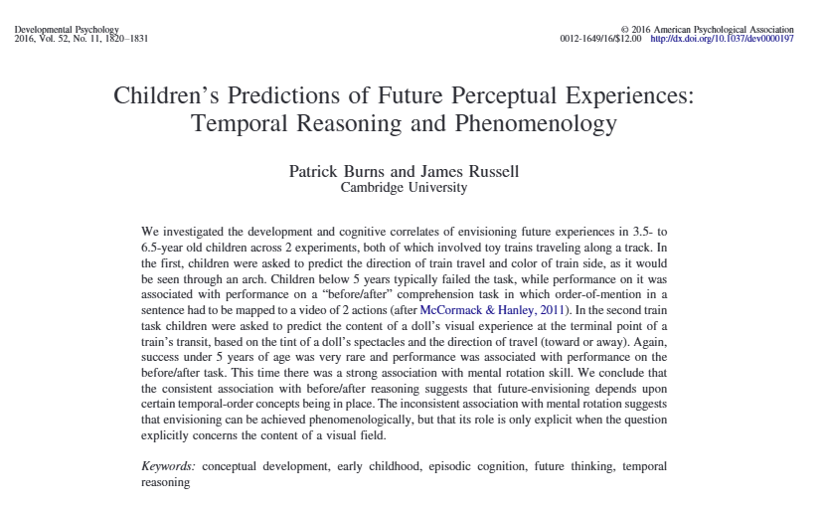
Examples of RT Studies For Tapping the Development of Different Cognitive Abilities:
Prediction (concepts of time)

Slide 29
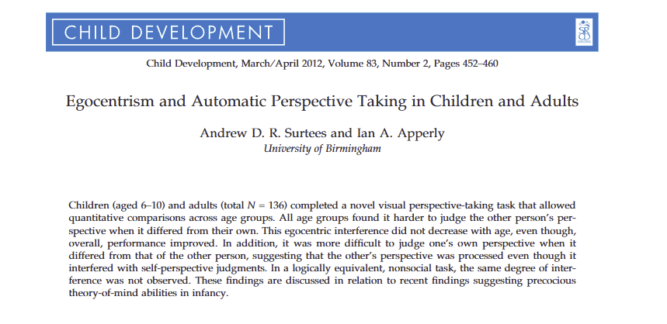
Examples of RT Studies For Tapping the Development of Different Cognitive Abilities:
Perspective Taking:
mental rotation? Theory of mind?

Slide 30
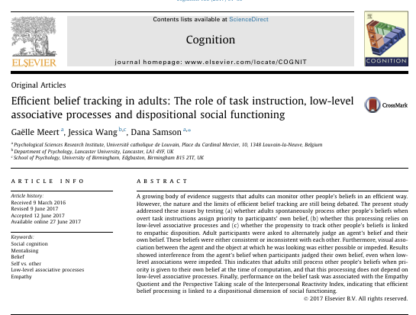
Examples of RT Studies For Tapping the Development of Different Cognitive Abilities:
Perspective Taking in Adults

Slide 31
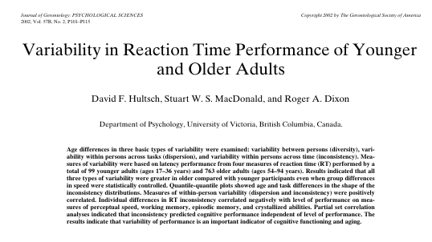
Examples of RT Studies For Tapping the Development of Different Cognitive Abilities:
Variability across tasks, within and across people

Slide 32
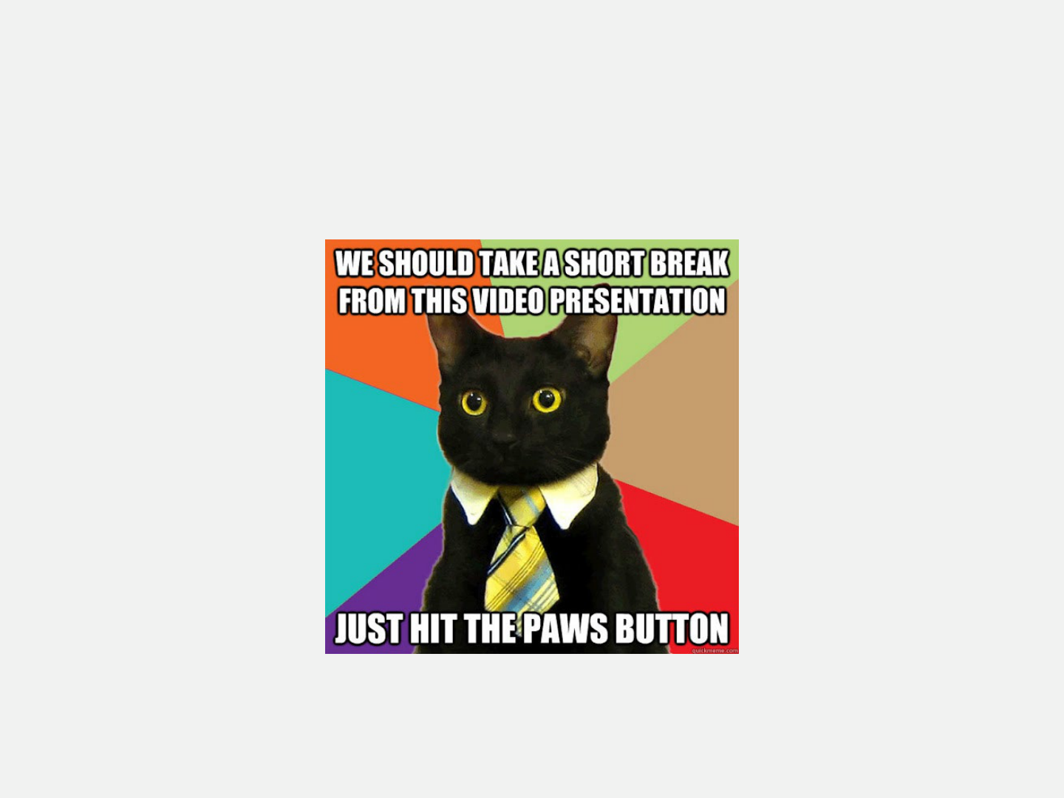

Slide 33
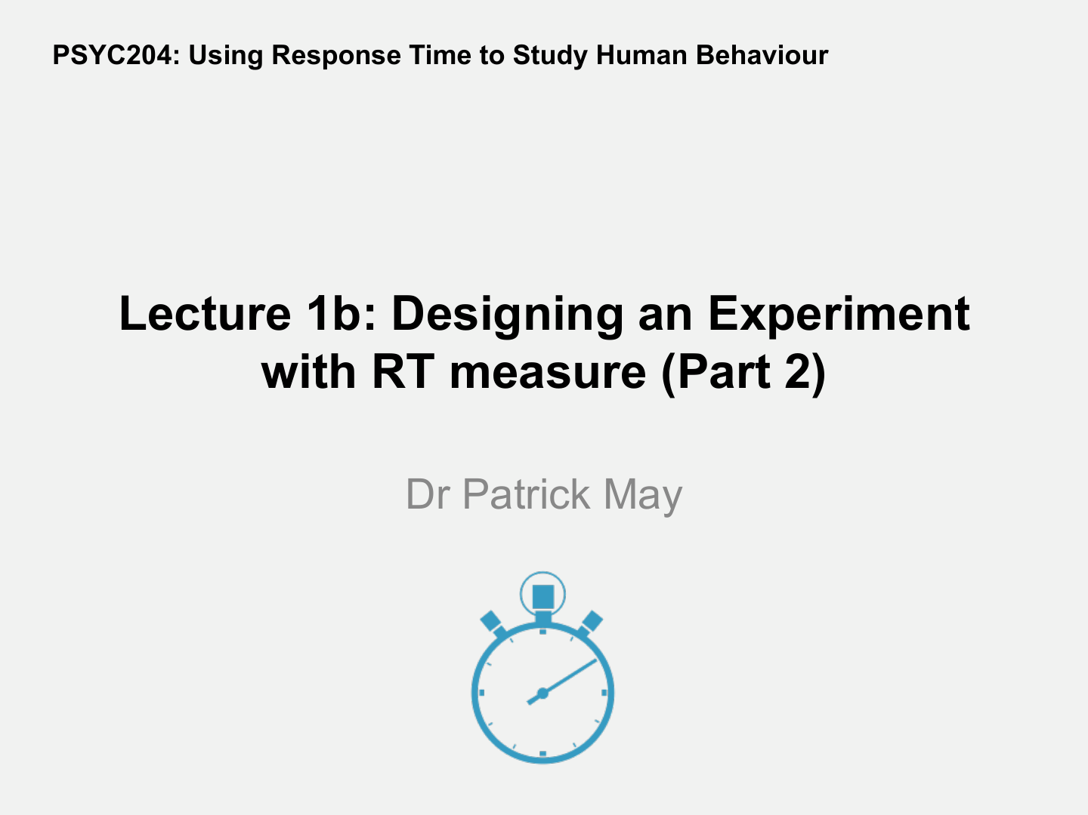
Dr Patrick May

Slide 34
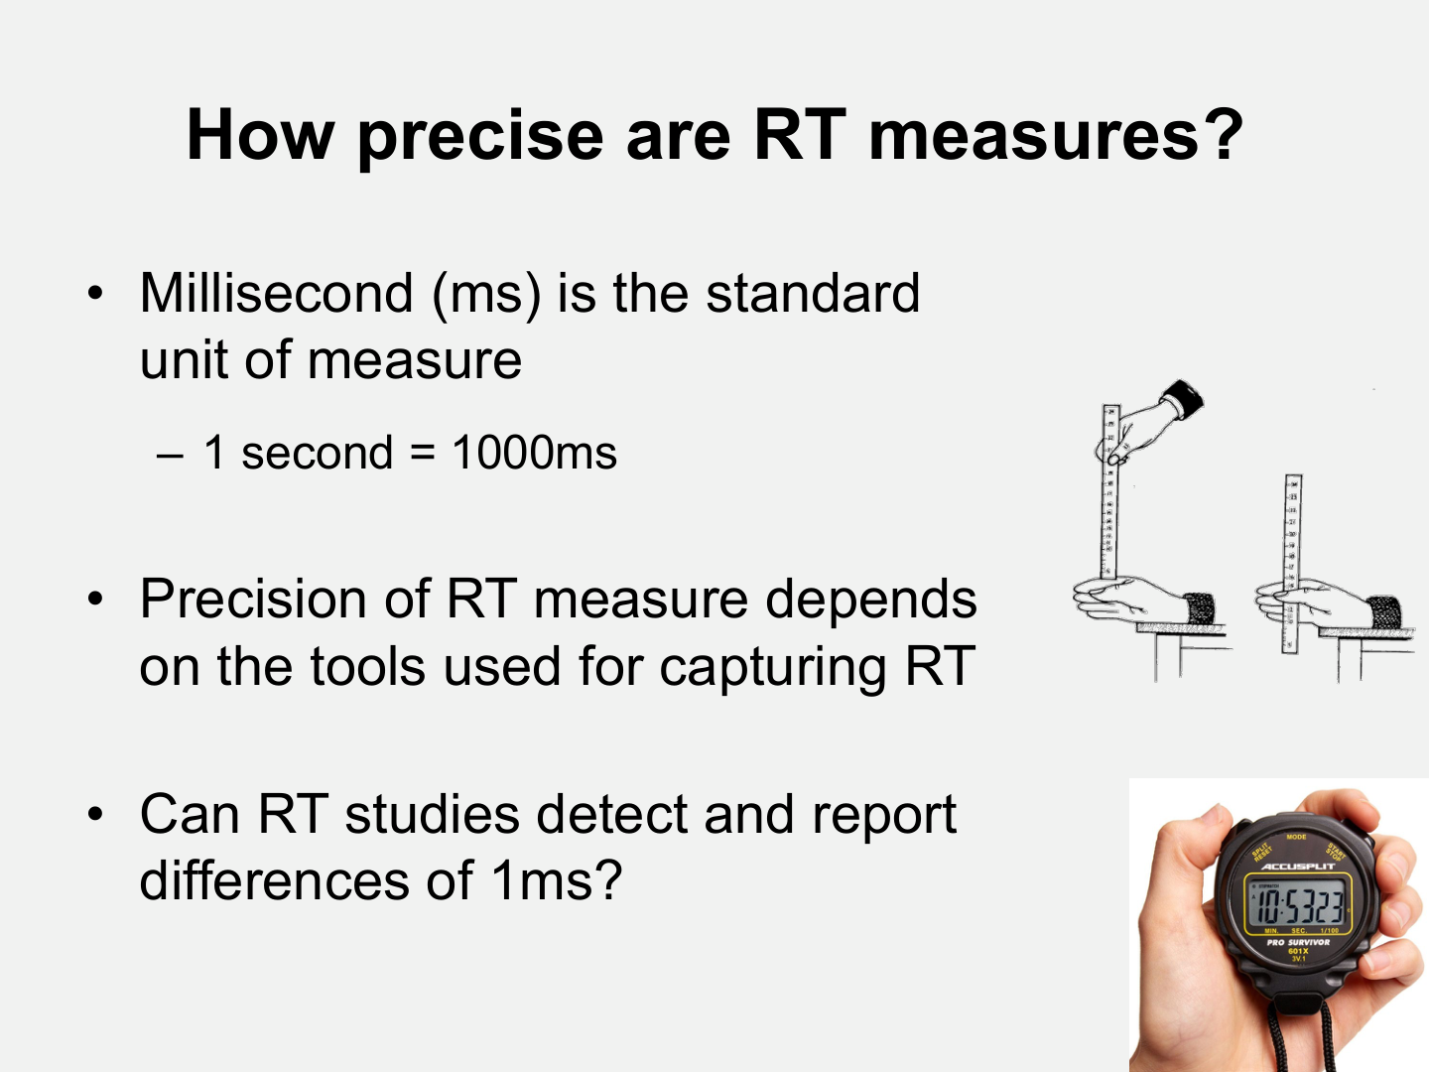
How precise are RT measures?
• Millisecond (ms) is the standard
unit of measure
– 1 second = 1000ms
• Precision of RT measure depends
on the tools used for capturing RT
• Can RT studies detect and report
differences of 1ms?

Slide 35
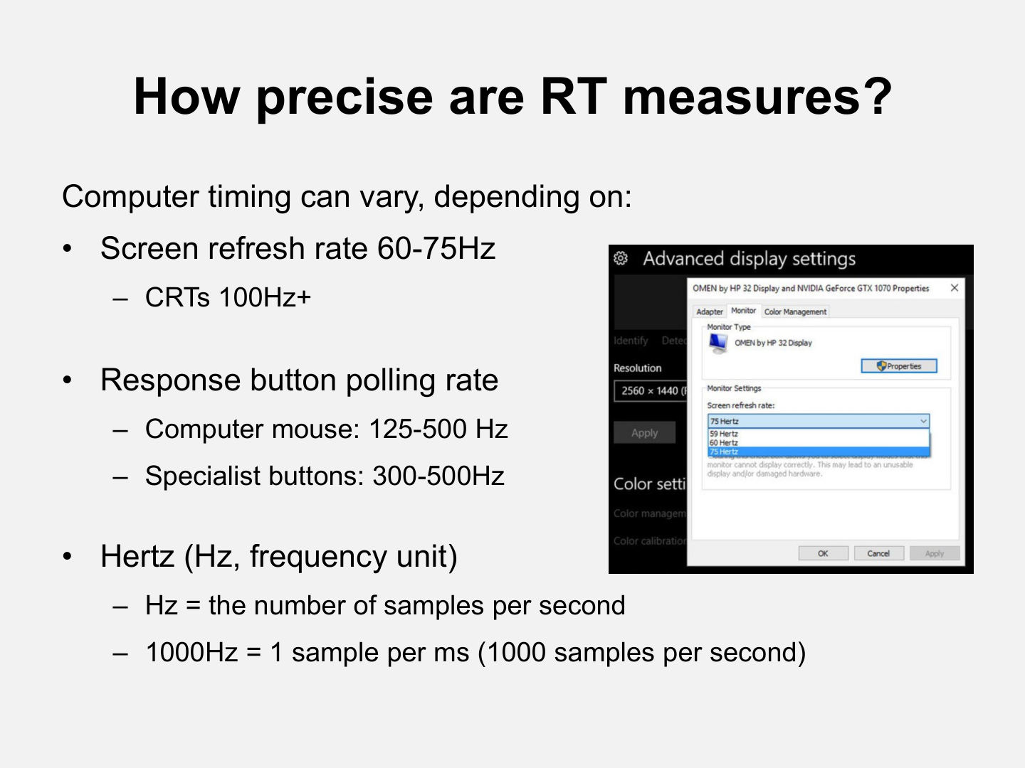
How precise are RT measures?
Computer timing can vary, depending on:
•
Screen refresh rate 60-75Hz
– CRTs 100Hz+
•
Response button polling rate
– Computer mouse: 125-500 Hz
– Specialist buttons: 300-500Hz
•
Hertz (Hz, frequency unit)
– Hz = the number of samples per second
– 1000Hz = 1 sample per ms (1000 samples per second)

Slide 36
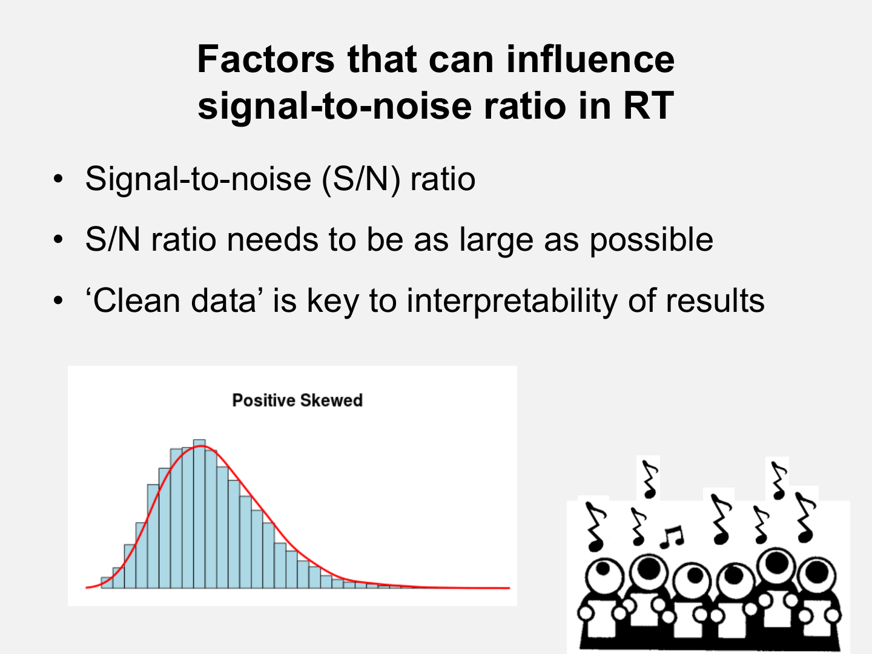
Factors that can influence
signal-to-noise ratio in RT
• Signal-to-noise (S/N) ratio
• S/N ratio needs to be as large as possible
• ‘Clean data’ is key to interpretability of results

Slide 37
Factors that can influence
signal-to-noise ratio in RT
• Signal-to-noise (S/N) ratio
• S/N ratio needs to be as large as possible
• ‘Clean data’ is key to interpretability of results

Slide 38
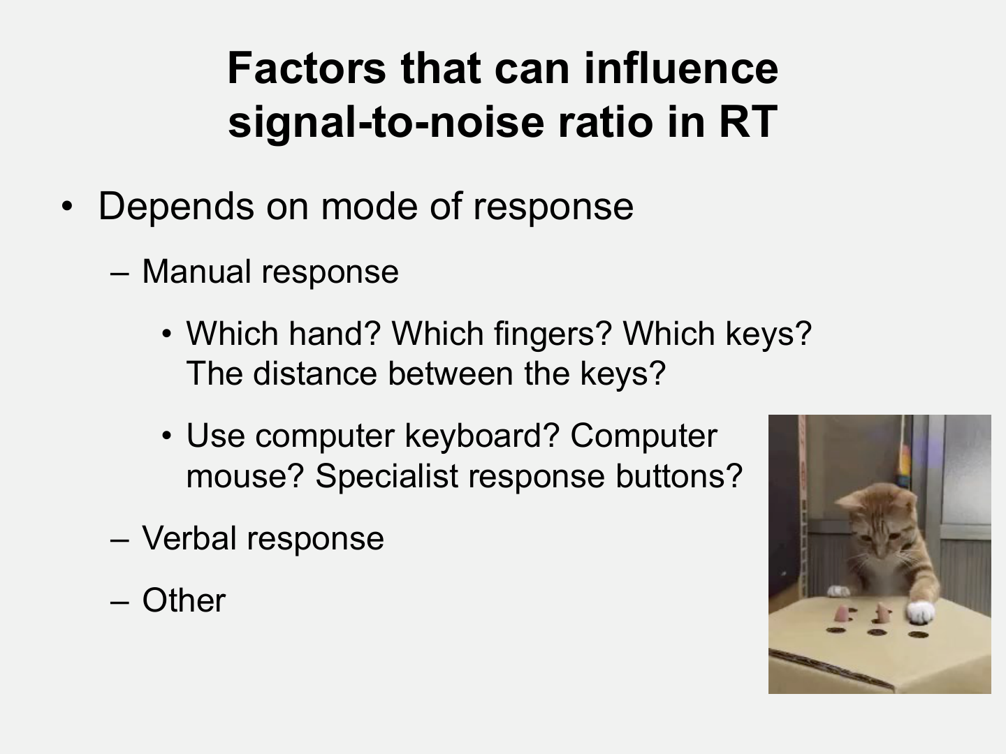
Factors that can influence
signal-to-noise ratio in RT
• Depends on mode of response
– Manual response
• Which hand? Which fingers? Which keys?
The distance between the keys?
• Use computer keyboard? Computer
mouse? Specialist response buttons?
– Verbal response
– Other

Slide 39
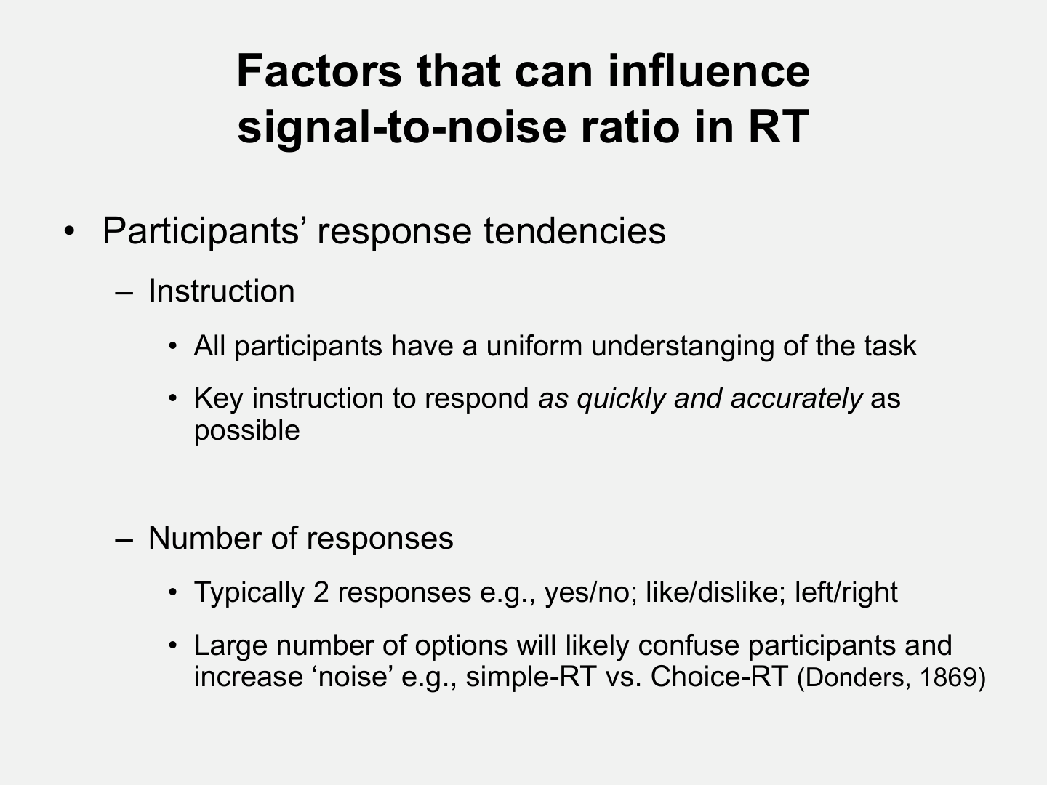
Factors that can influence
signal-to-noise ratio in RT
• Participants’ response tendencies
– Instruction
• All participants have a uniform understanging of the task
• Key instruction to respond as quickly and accurately as
possible
– Number of responses
• Typically 2 responses e.g., yes/no; like/dislike; left/right
• Large number of options will likely confuse participants and
increase ‘noise’ e.g., simple-RT vs. Choice-RT (Donders, 1869)

Slide 40
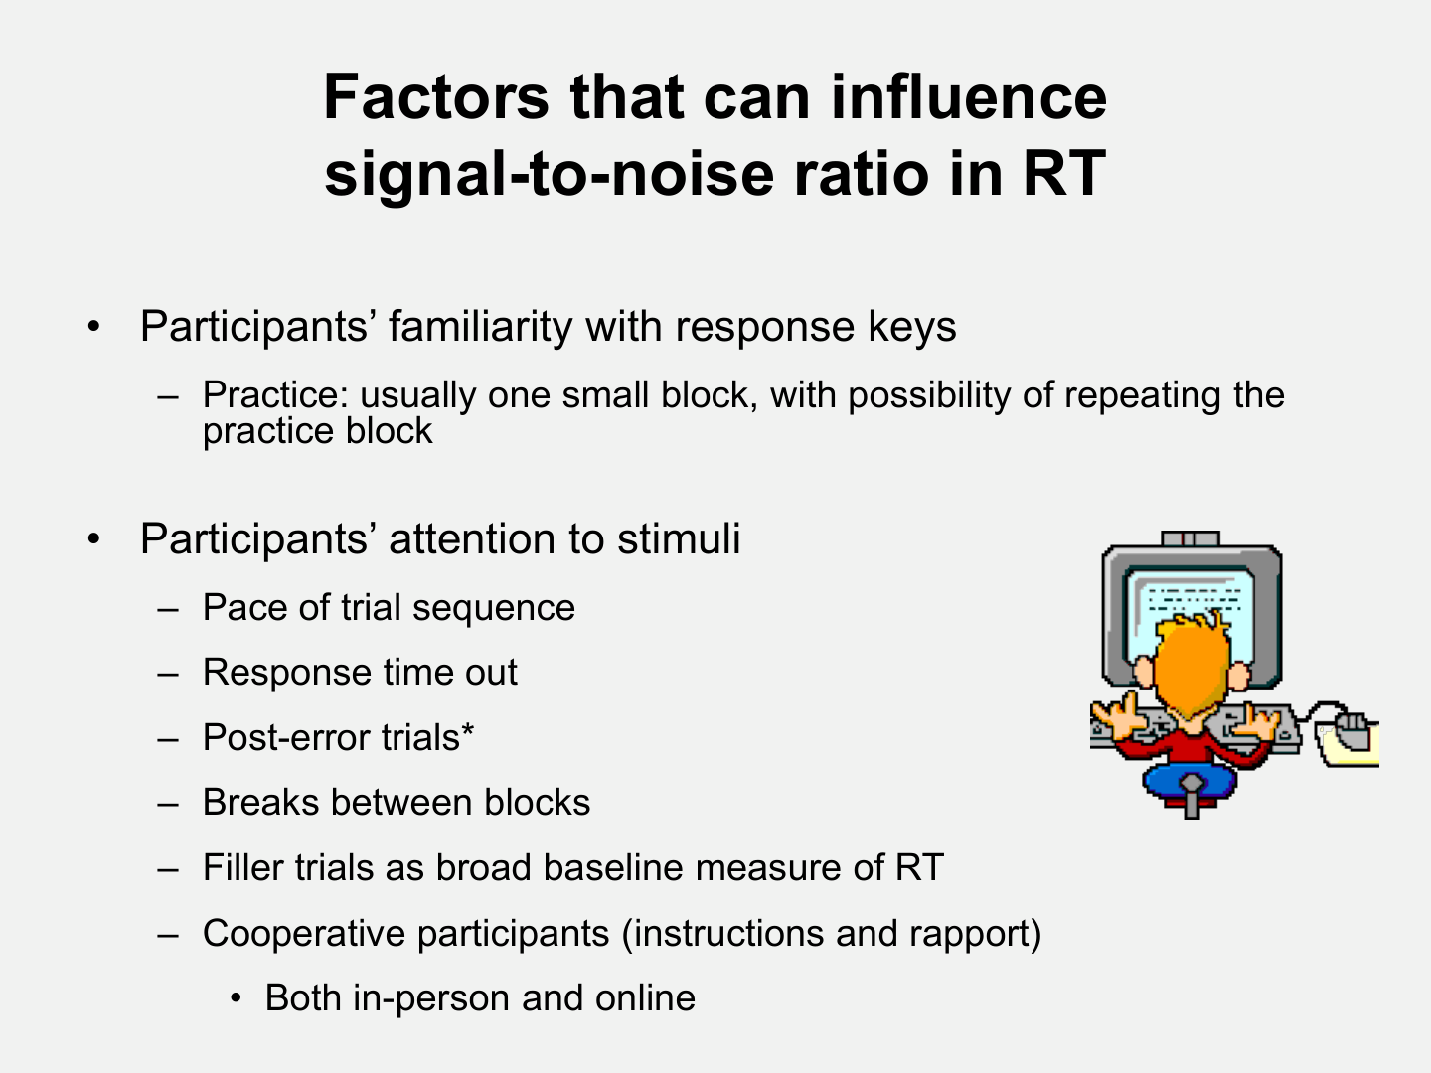
Factors that can influence
signal-to-noise ratio in RT
•
Participants’ familiarity with response keys
– Practice: usually one small block, with possibility of repeating the
practice block
•
Participants’ attention to stimuli
– Pace of trial sequence
– Response time out
– Post-error trials*
– Breaks between blocks
– Filler trials as broad baseline measure of RT
– Cooperative participants (instructions and rapport)
• Both in-person and online

Slide 41
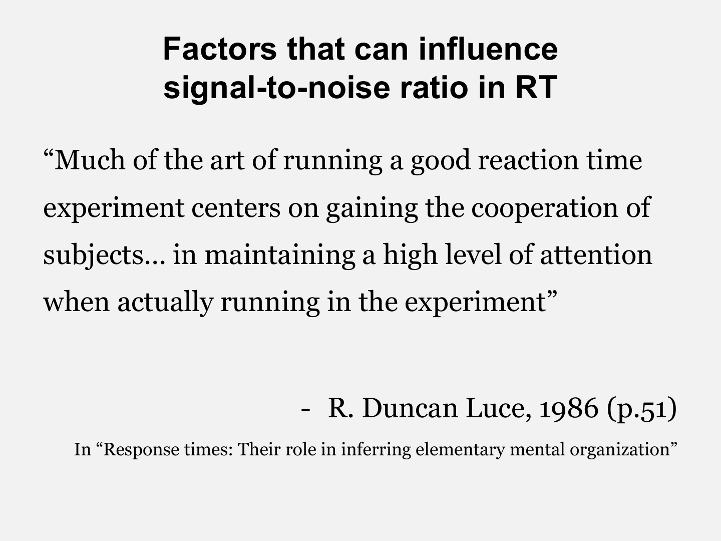
Factors that can influence
signal-to-noise ratio in RT
“Much of the art of running a good reaction time
experiment centers on gaining the cooperation of
subjects… in maintaining a high level of attention
when actually running in the experiment”
- R. Duncan Luce, 1986 (p.51)
In “Response times: Their role in inferring elementary mental organization”

Slide 42
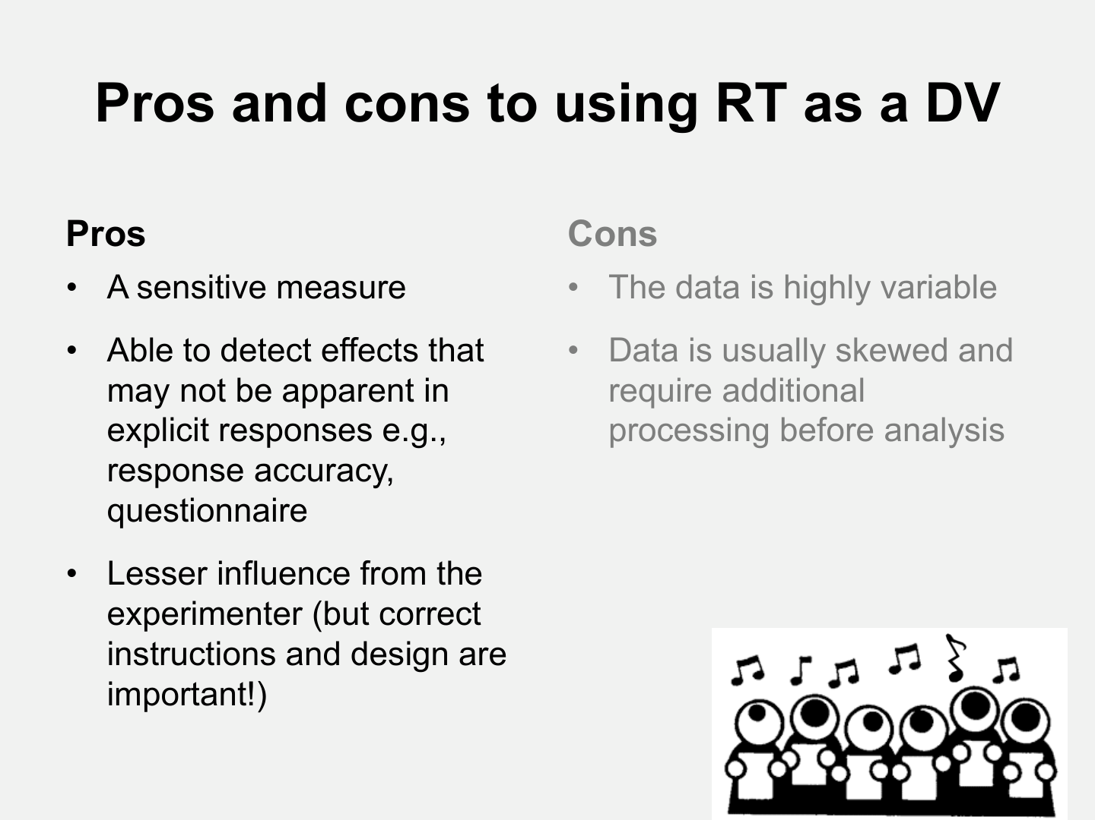
Pros and cons to using RT as a DV
Pros
Cons
•
A sensitive measure
•
The data is highly variable
•
Able to detect effects that
may not be apparent in
explicit responses e.g.,
response accuracy,
questionnaire
•
Data is usually skewed and
require additional
processing before analysis
•
Lesser influence from the
experimenter (but correct
instructions and design are
important!)

Slide 43
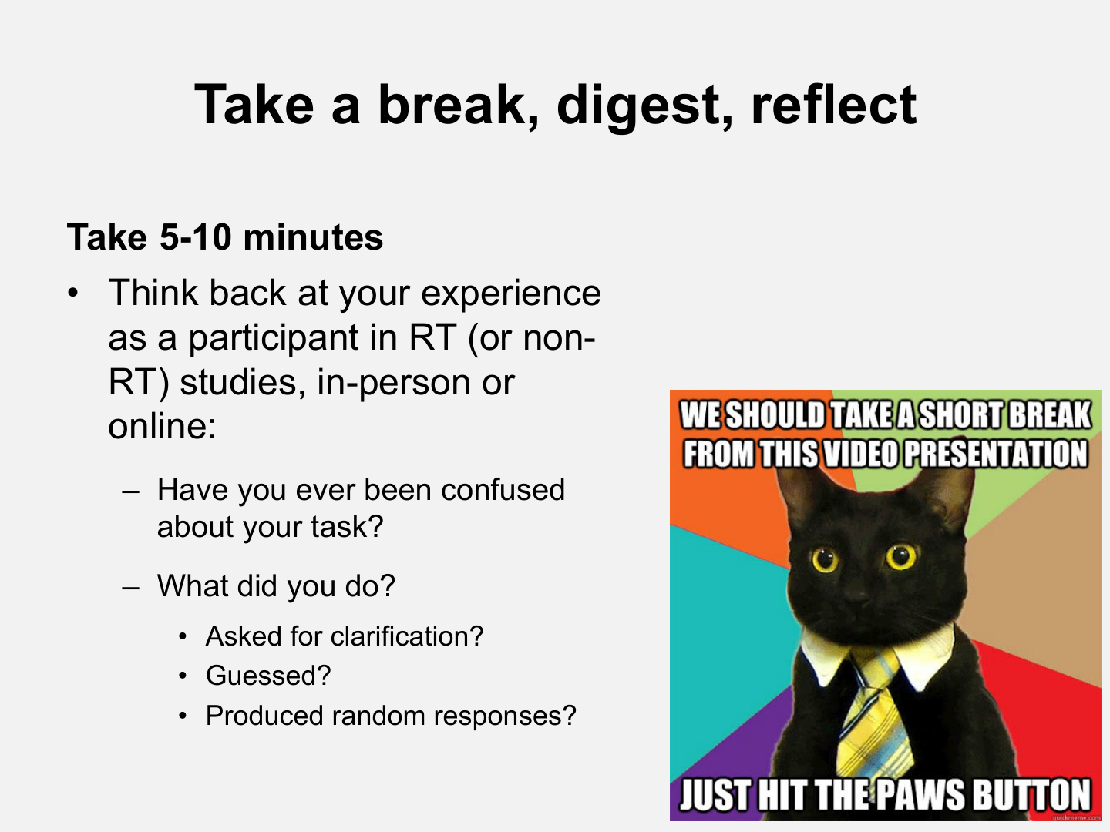
Take a break, digest, reflect
Take 5-10 minutes
• Think back at your experience
as a participant in RT (or non-
RT) studies, in-person or
online:
– Have you ever been confused
about your task?
– What did you do?
• Asked for clarification?
• Guessed?
• Produced random responses?

Slide 44
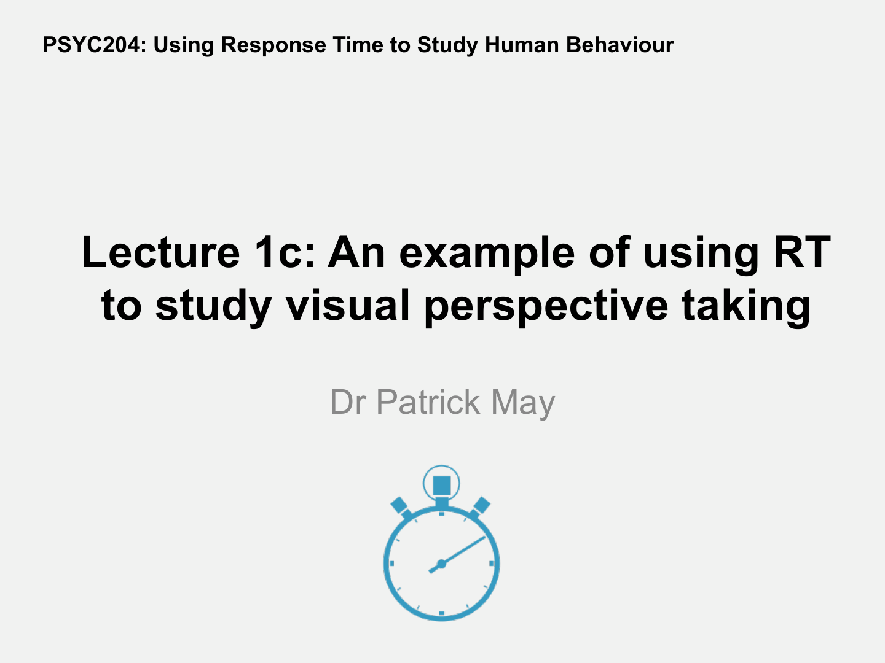
PSYC204: Using Response Time to Study Human Behaviour
Lecture 1c: An example of using RT
to study visual perspective taking
Dr Patrick May

Slide 45
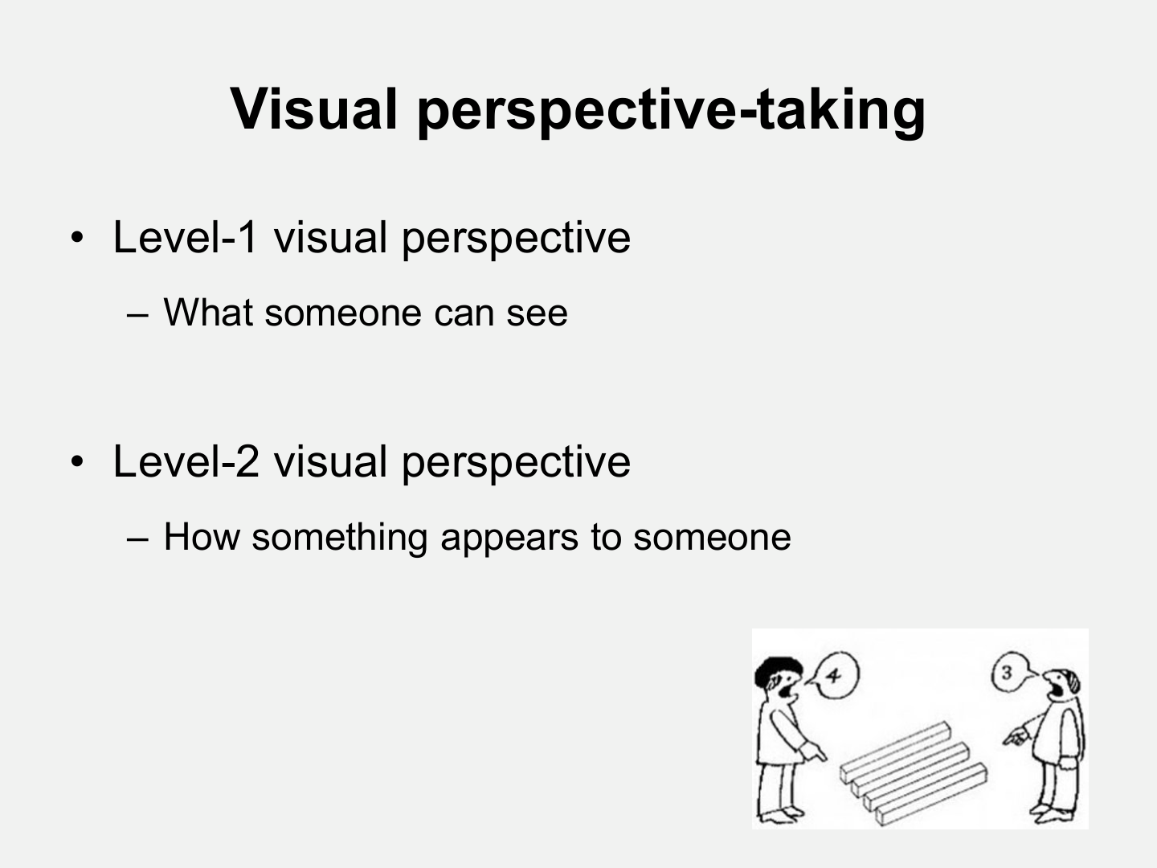
Visual perspective-taking
• Level-1 visual perspective
– What someone can see
• Level-2 visual perspective
– How something appears to someone

Slide 46
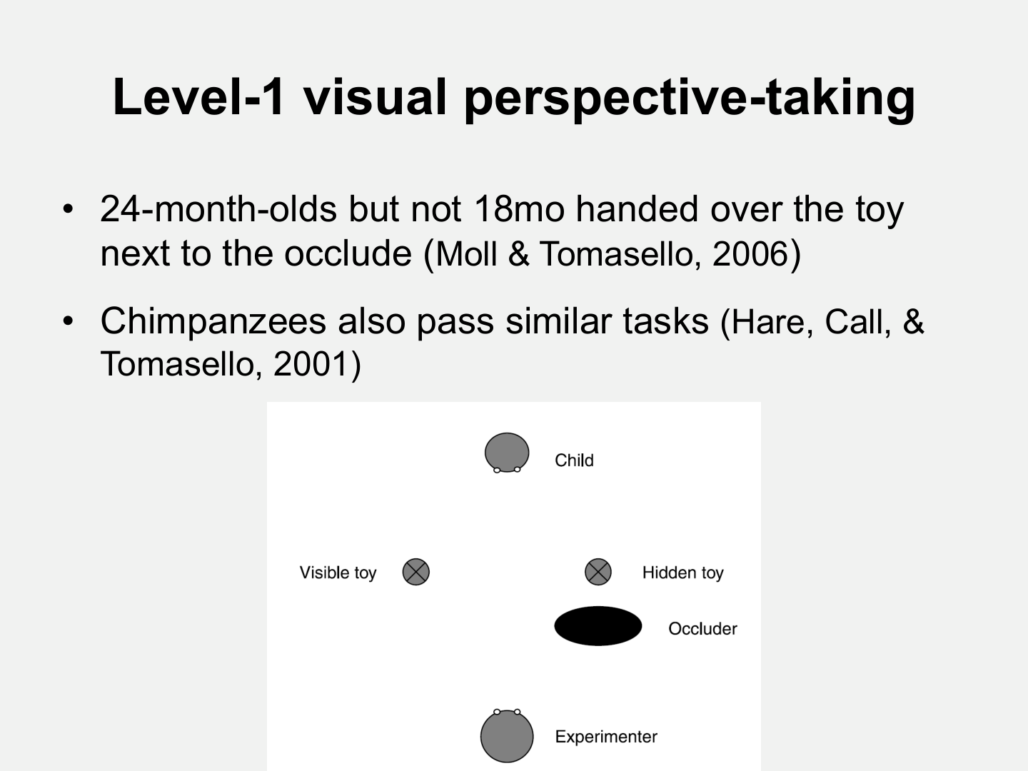
Level-1 visual perspective-taking
• 24-month-olds but not 18mo handed over the toy
next to the occlude (Moll & Tomasello, 2006)
• Chimpanzees also pass similar tasks (Hare, Call, &
Tomasello, 2001)

Slide 47
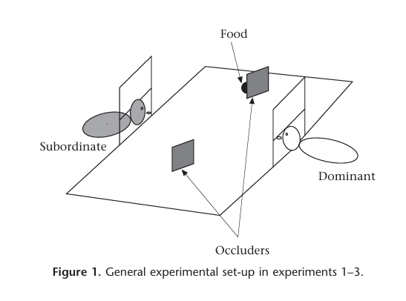
Level-1 visual perspective-taking
• 24-month-olds but not 18mo handed over the toy
next to the occlude (Moll & Tomasello, 2006)
• Chimpanzees also pass similar tasks (Hare, Call, &
Tomasello, 2001)

Slide 48
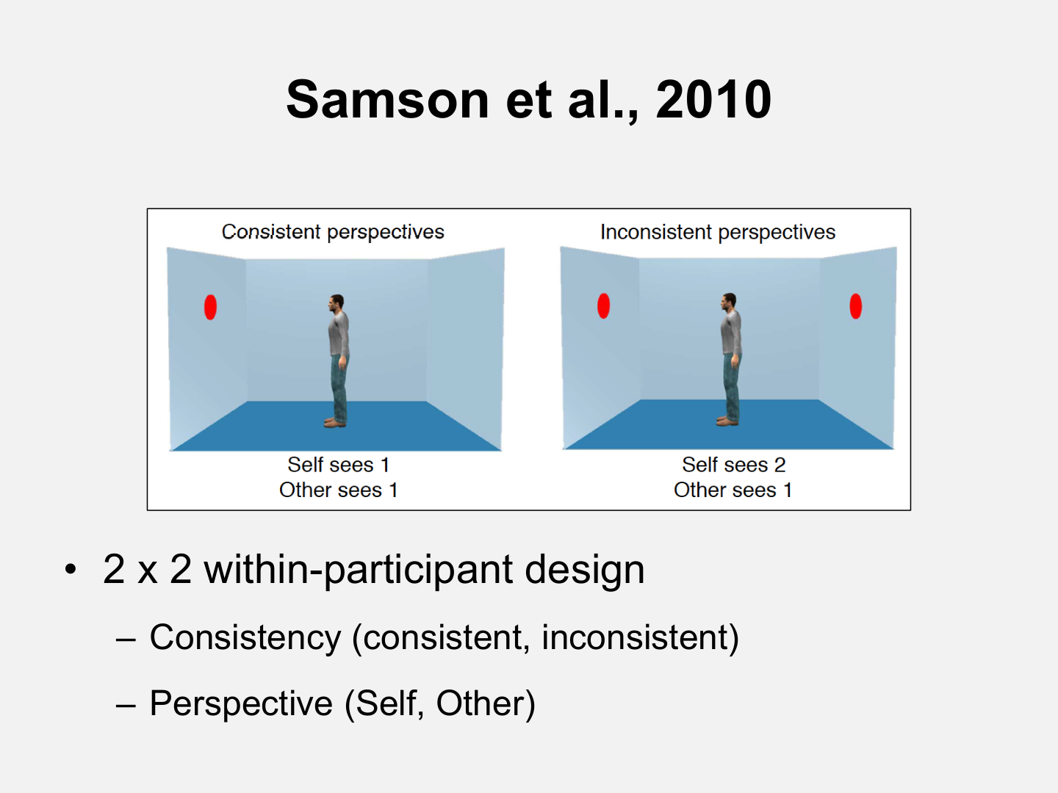
Samson et al., 2010
• 2 x 2 within-participant design
– Consistency (consistent, inconsistent)
– Perspective (Self, Other)

Slide 49
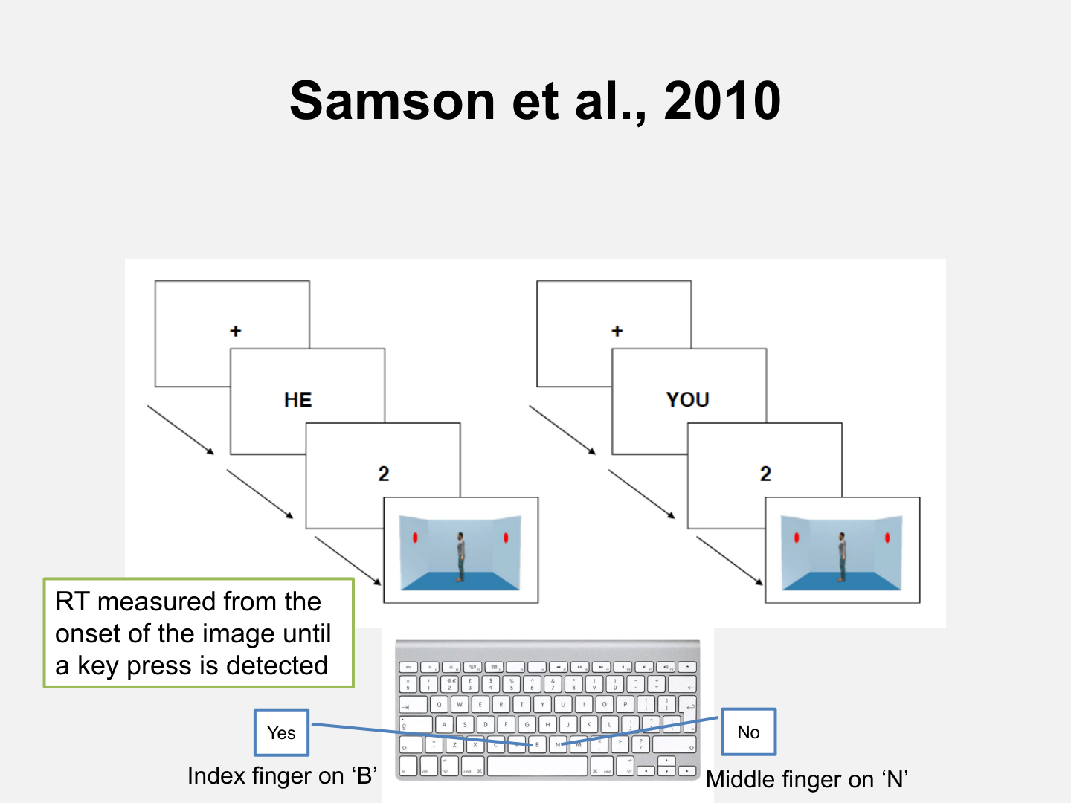
Samson et al., 2010
RT measured from the
onset of the image until
a key press is detected
No
Yes
Index finger on ‘B’
Middle finger on ‘N’

Slide 50
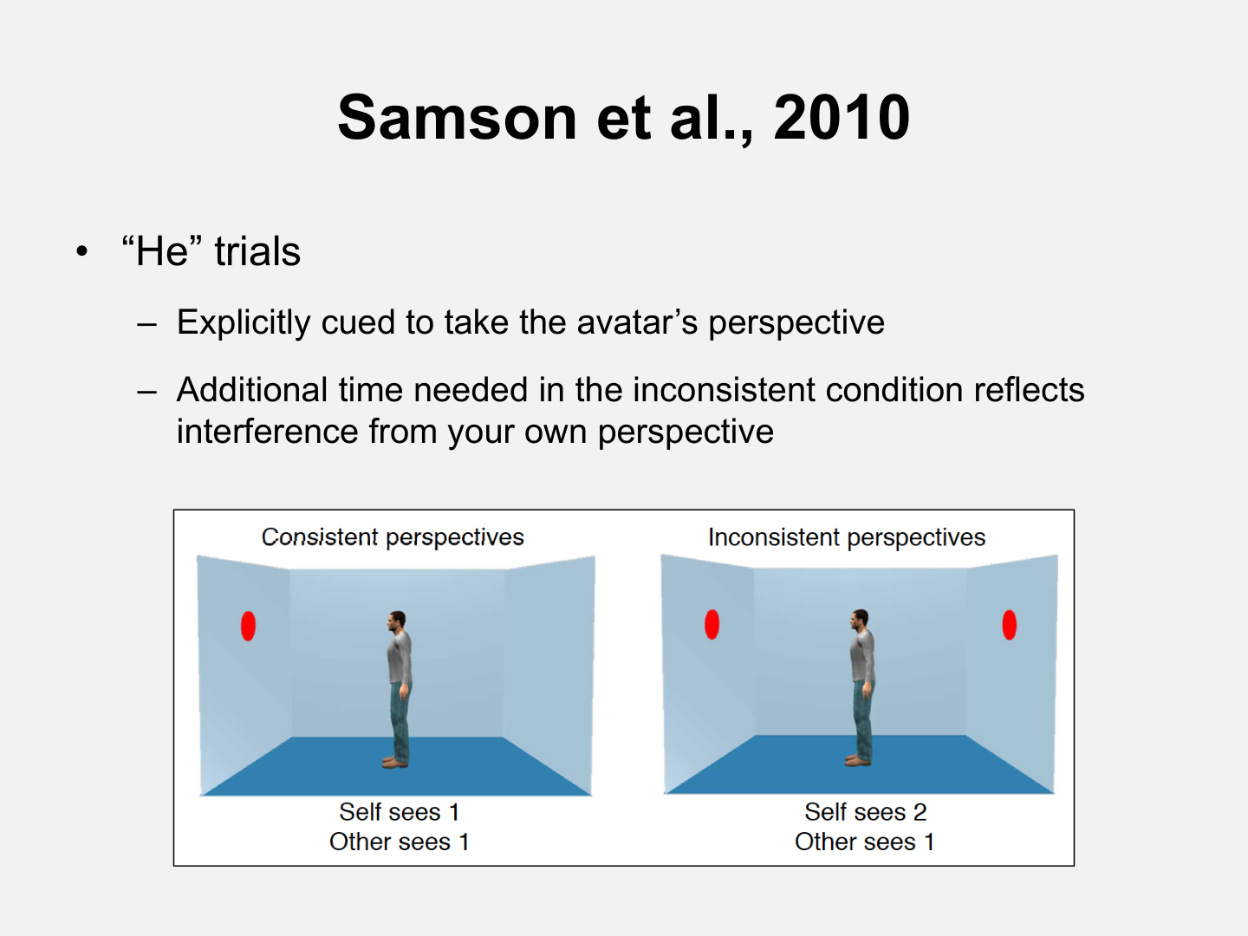
Samson et al., 2010
• “He” trials
– Explicitly cued to take the avatar’s perspective
– Additional time needed in the inconsistent condition reflects
interference from your own perspective

Slide 51
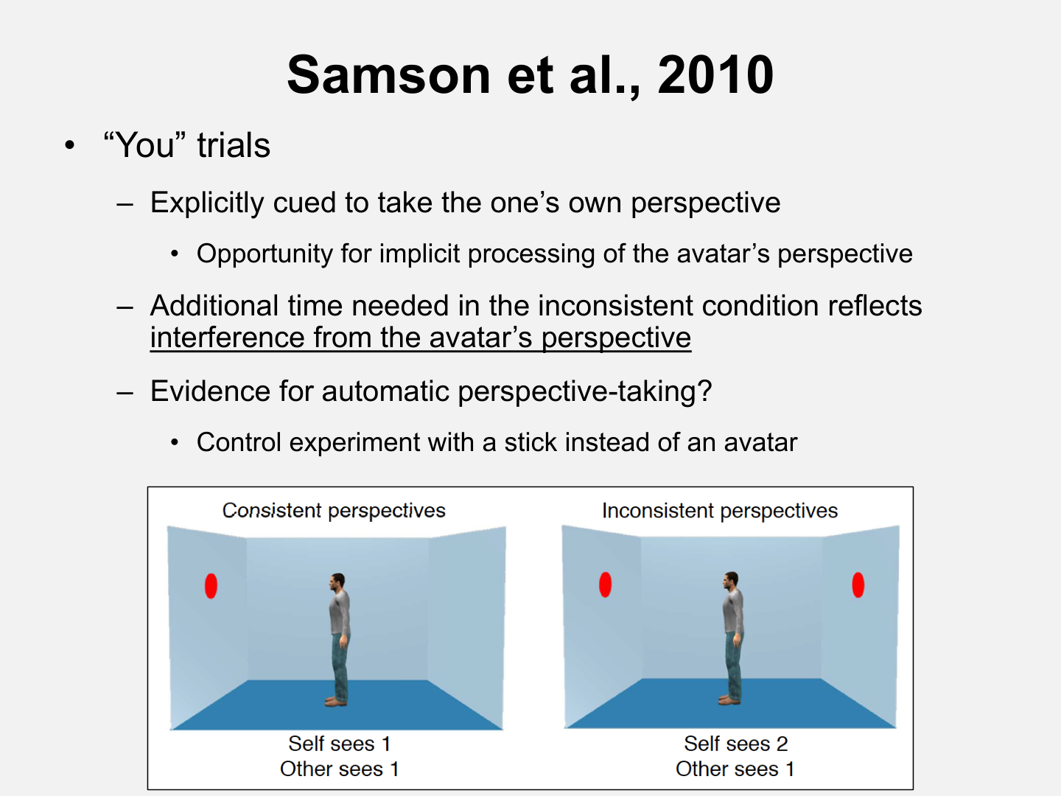
Samson et al., 2010
• “You” trials
– Explicitly cued to take the one’s own perspective
• Opportunity for implicit processing of the avatar’s perspective
– Additional time needed in the inconsistent condition reflects
interference from the avatar’s perspective
– Evidence for automatic perspective-taking?
• Control experiment with a stick instead of an avatar

Slide 52
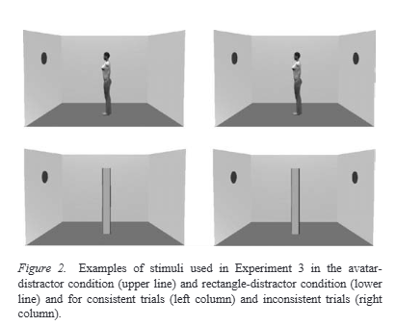
Samson et al., 2010
• “You” trials
– Explicitly cued to take the one’s own perspective
• Opportunity for implicit processing of the avatar’s perspective
– Additional time needed in the inconsistent condition reflects
interference from the avatar’s perspective
– Evidence for automatic perspective-taking?
• Control experiment with a stick instead of an avatar

Slide 53
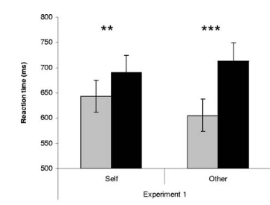

Samson et al., 2010
Egocentric Effect:
Other-Inconsistent >
Other-Consistent

Slide 54
Samson et al., 2010
Altercentric Effect:
Self-Inconsistent
>
Self-Consistent
Spontaneous processing of the avatar's perspective
  (even when not required)

Slide 55
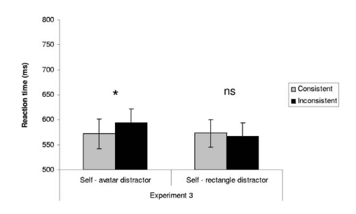
Samson et al., 2010
Altercentric Effect:
Disappears when the object is no longer a social object

Slide 56
Samson et al., 2010
Response time:
Main effect of consistency
= across both perspectives, inconsistent trials are slower than consistent trials

Slide 57
Samson et al., 2010
Response time:
Non-significant effect of perspective
= trials were equivalently fast / slow across perspectives

Slide 58
Samson et al., 2010
Response time:
Interaction between consistency and perspective
= difference between other trials were larger than difference between self trials

Slide 59
Samson et al., 2010
Response time:
Interaction between consistency and perspective
= larger Egocentric effect than Altercentric effect

Slide 60
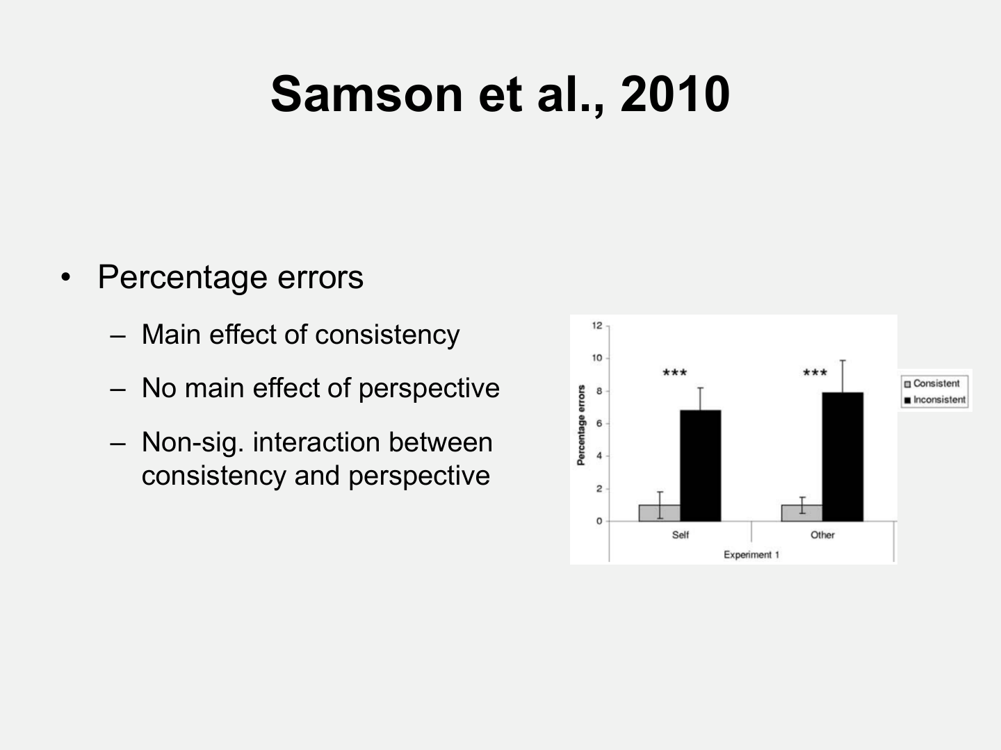
Samson et al., 2010
• Percentage errors
– Main effect of consistency
– No main effect of perspective
– Non-sig. interaction between
consistency and perspective

Slide 61
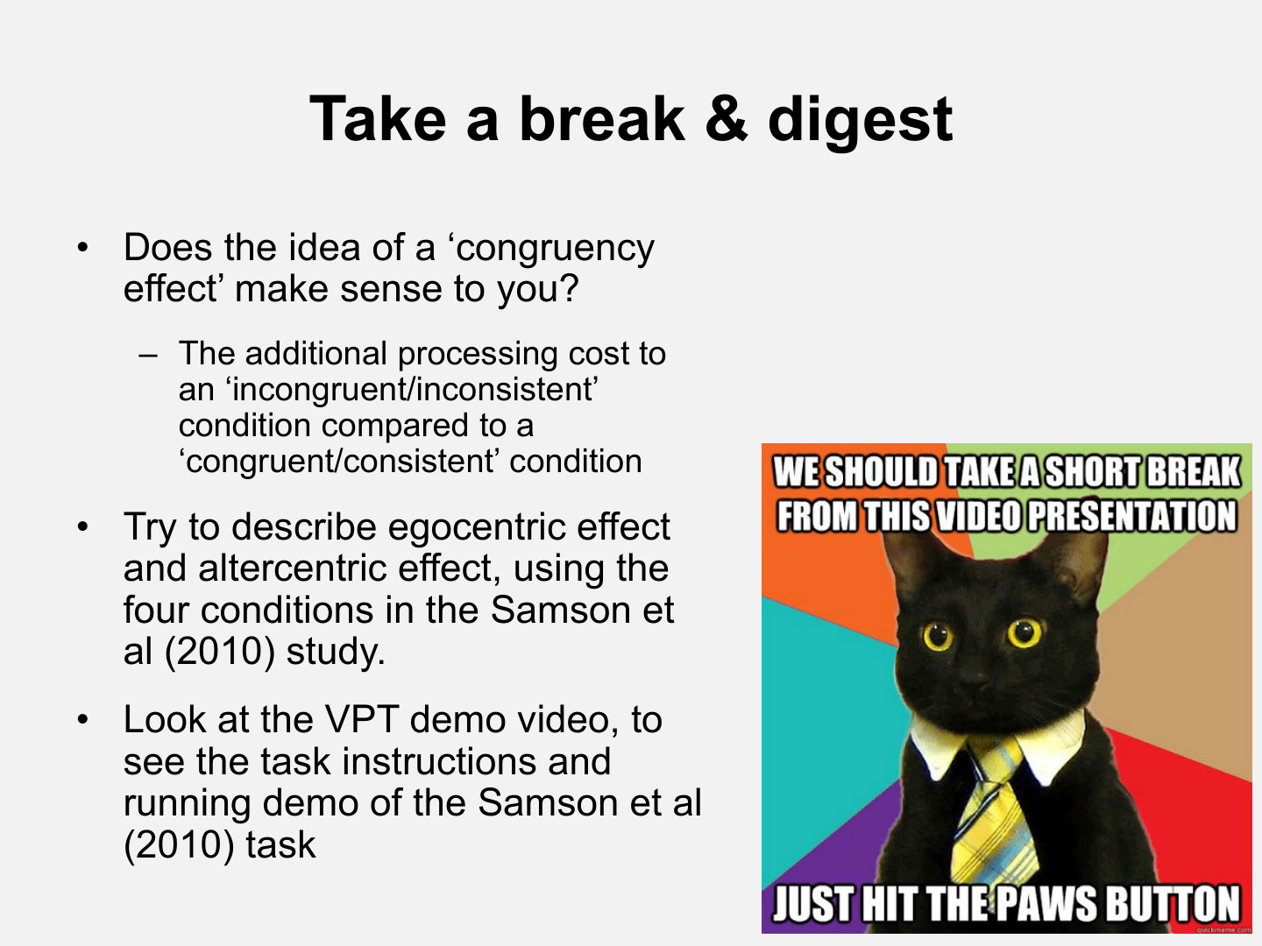
Take a break & digest
•
Does the idea of a ‘congruency
effect’ make sense to you?
– The additional processing cost to
an ‘incongruent/inconsistent’
condition compared to a
‘congruent/consistent’ condition
•
Try to describe egocentric effect
and altercentric effect, using the
four conditions in the Samson et
al (2010) study.
•
Look at the VPT demo video, to
see the task instructions and
running demo of the Samson et al
(2010) task

